Slide 1
Machine learning in python – Essential python programming

Slide 2
Synopsis
Introduction to python - Installation
Basic Python syntax and first coding lesson
Variables and Data types in python
Python sequences – List, Tuples, Dictionaries
Decision making - If-Else
Python Loops
Advanced python tools – Python libraries and modules
Python for data visualization

Slide 3
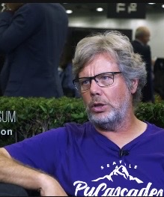
Introduction
Brief History of Python
Created in 1990 by Guido Van Rossum
Python 3 released in 2008

Slide 4
Why Python ?
Readability - Python has a simple syntax similar to the English language.
Designed for clear, logical code that is easy to read and learn.
Lots of existing libraries and frameworks written in Python allowing users to apply Python to wide variety of tasks.
Python has syntax that allows developers to write programs with fewer lines than some other programming languages.

Slide 5
Python for Data Science
Analyze large data files
Create visualizations
Perform machine learning tasks
Create and run predictive algorithms

Slide 6
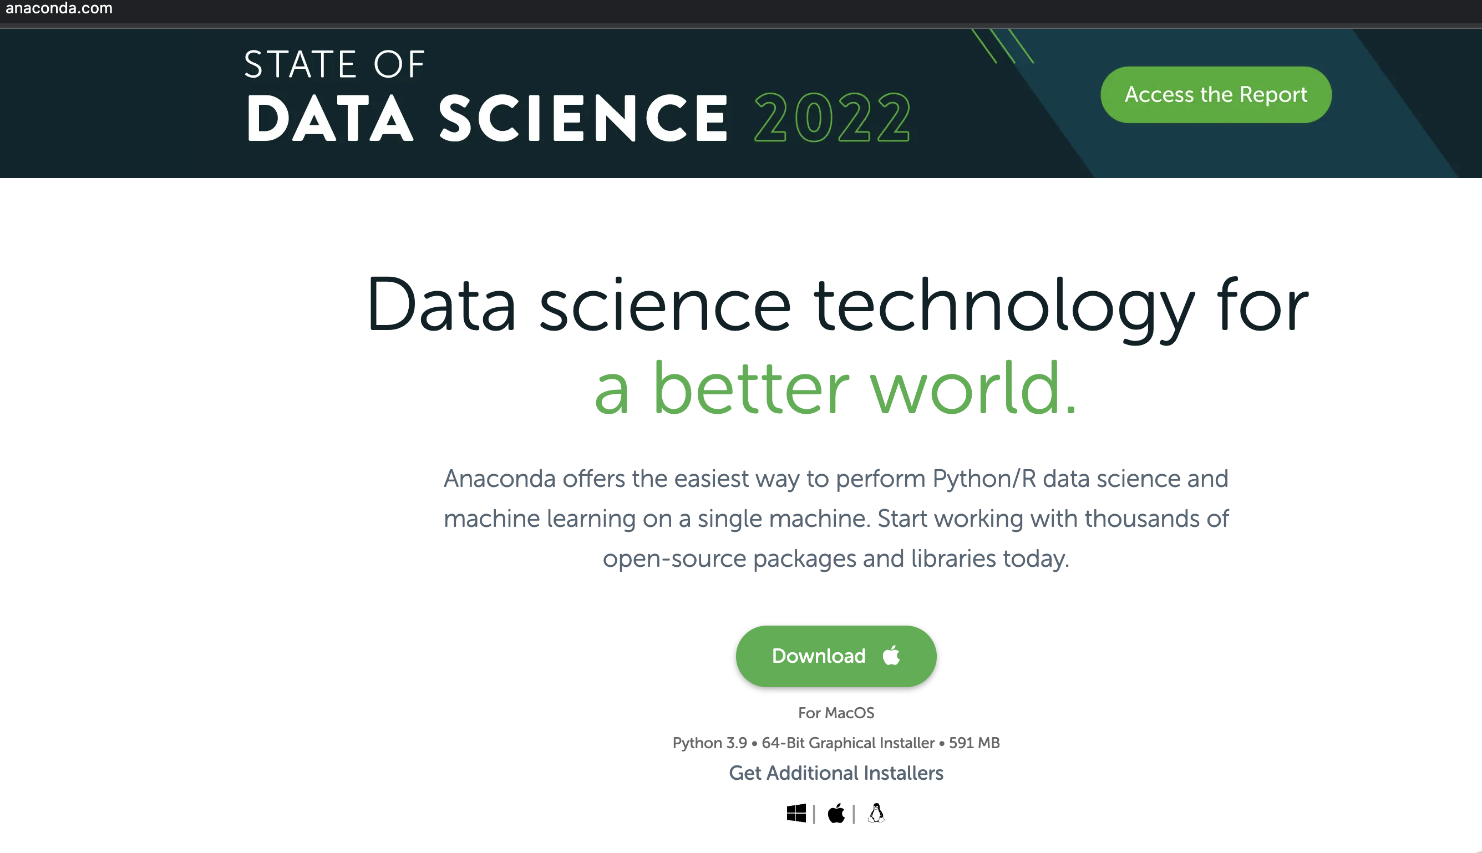
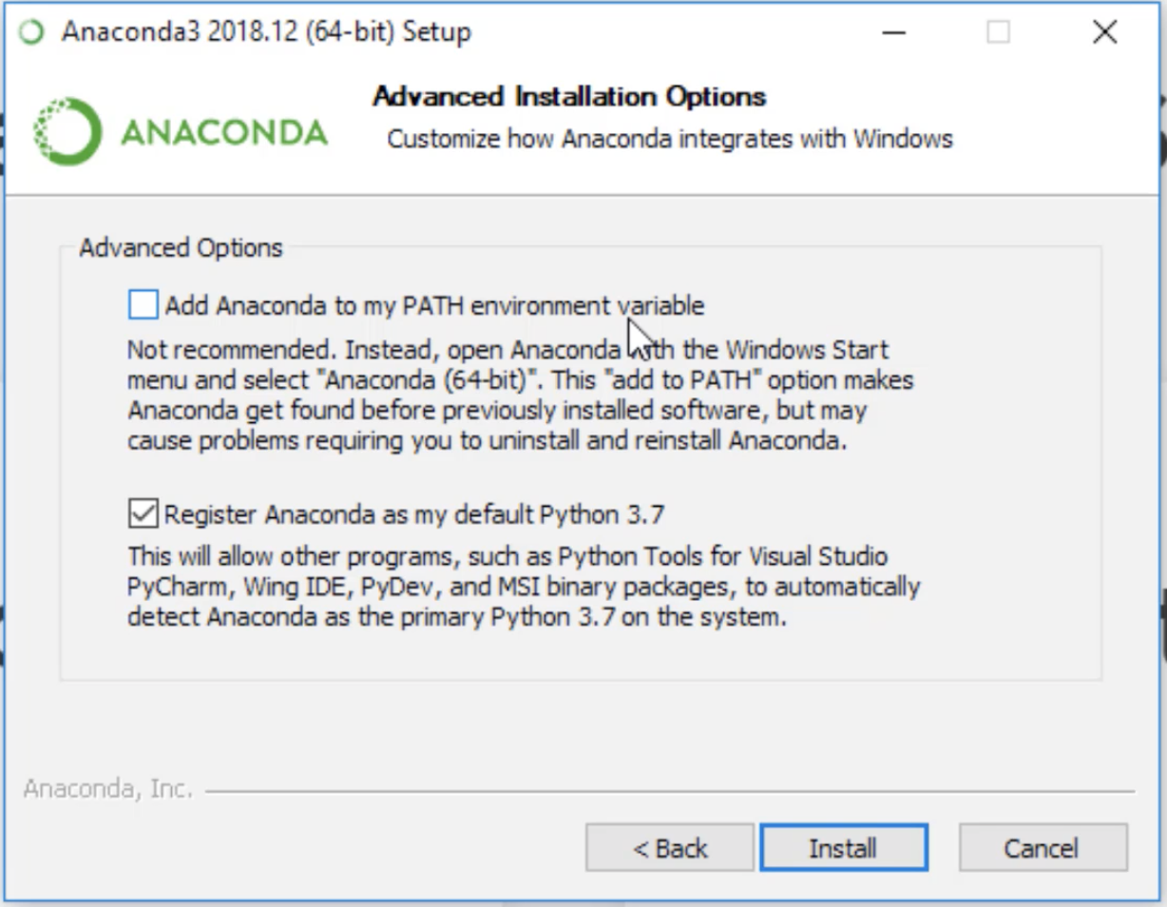
Python Installation
Go to:
https://www.anaconda.com/
Or simply Google Search:
“Anaconda Python Download”
After Downloading, Click on Next Button prompted on the popup.
For Windows Users, Please Click on the first box as well.

Slide 7
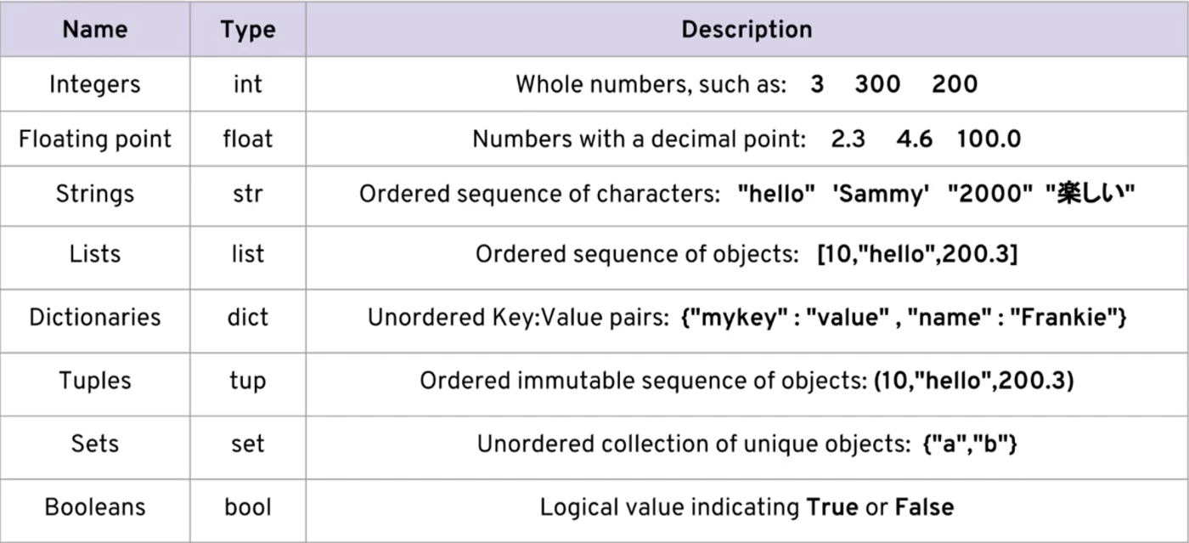
Basic Python Syntax and First Coding Lesson
PYTHON Data Types

Slide 8
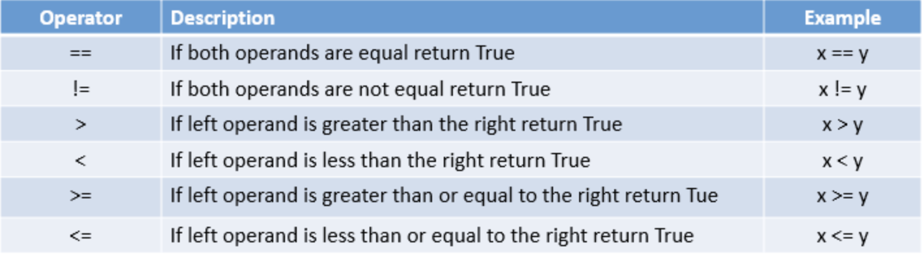
Python Comparison Operators

Slide 9
Decision making - If-Else
There comes situations in real life when we need to make some decisions and based on these decisions, we decide what should we do next.
Similar situations arise in programming also where we need to make some decisions and based on these decisions, we will execute the next block of code.
For example, if my cat is hungry (condition), then I will feed the dog (action).
Decision-making statements in programming languages decide the direction of the flow of program execution.
In Python, if-else elif statement is used for decision making.

Slide 10
To control this flow of logic we use some keywords:
If
elif
Else
if statement
It is used to decide whether a certain statement or block of statements will be executed or not i.e if a certain condition is true then a block of statement is executed otherwise not.
Syntax
if condition:
# Statements to execute if
# condition is true

Slide 11
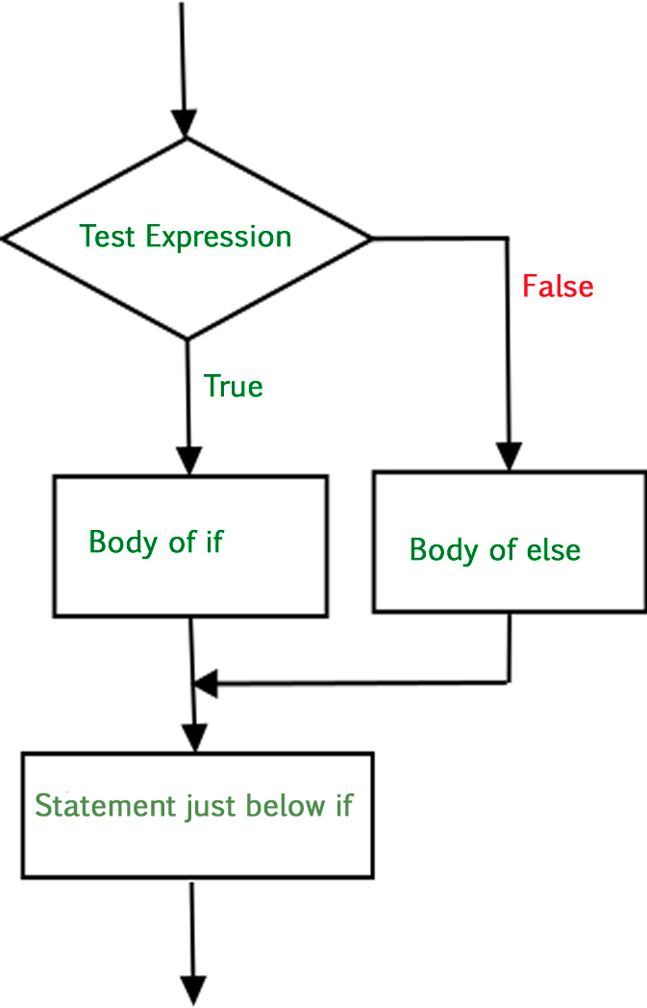
if-else
We can use the else statement with if statement to execute a block of code when the condition is false.
Syntax:
if (condition):
# Executes this block if
# condition is true
else:
# Executes this block if
# condition is false

Slide 12
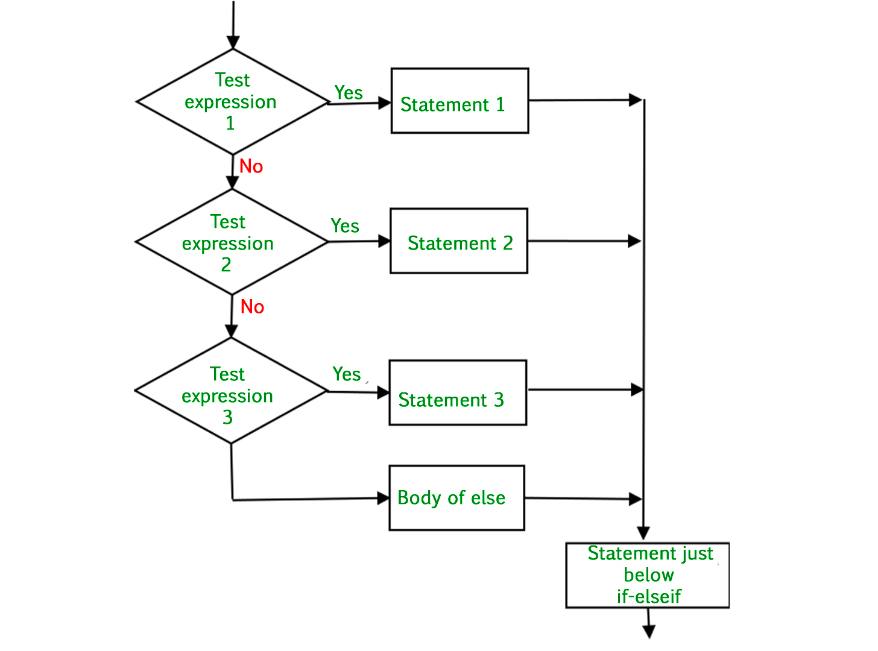
if-elif-else ladder
The elif statement allows to check multiple expressions for TRUE and execute a block of code as soon as one of the conditions evaluates to TRUE.
Syntax:
if (condition):
statement
elif (condition):
statement
.
.
else: statement

Slide 13
Python Loops
For Loop
A for loop is used for iterating over a sequence (that is either a list, a tuple, a dictionary, a set, or a string).
With the break statement we can stop the loop before it has looped through all the items.
With the continue statement we can stop the current iteration of the loop, and continue with the next.
Syntax :
for val in sequence:
loop body

Slide 14
While Loop
While Loops will continue to execute block of code while some condition remains True.
Syntax:
while some_Boolean_condition:
# do something

Slide 15
Advanced python tools - Python libraries and modules
Python libraries that are used in Machine Learning are:
Numpy – A python library for creating N-dimentional arrays. Built in linear algebra, statistical distribution, random number capabilities.
Pandas - Python package providing fast, flexible, and expressive data structures designed to make working with “relational” or “labeled” data both easy and intuitive.
Scikit-learn - The sklearn library contains a lot of efficient tools for machine learning and statistical modeling including classification, regression, clustering and dimensionality reduction.
Keras - Keras is a high-level, deep learning API developed by Google for implementing neural networks.

Slide 16
Tensorflow - TensorFlow is an open source machine learning framework for all developers. It is used for implementing machine learning and deep learning applications.

Slide 17
Data Visualization
Python libraries that are used for Visualization are:
Matplotlib - Matplotlib is utilized for making basic graphs. Datasets are visualised with the help of bargraphs, histograms, piecharts, scatter plots, lines and so on.
Seaborn - Seaborn is a Python data visualization library based on matplotlib. It contains a number of patterns and plots for data visualization. It uses fascinating themes. It helps in compiling whole data into a single plot. It also provides distribution of data.

Slide 18

Questions

